Slide 1

CHAPTER 4
ELEMENTARY NUMBER THEORY AND METHODS OF PROOF
Copyright © Cengage Learning. All rights reserved.

Slide 2

4.9
Application: The Handshake Theorem
Copyright © Cengage Learning. All rights reserved.

Slide 3
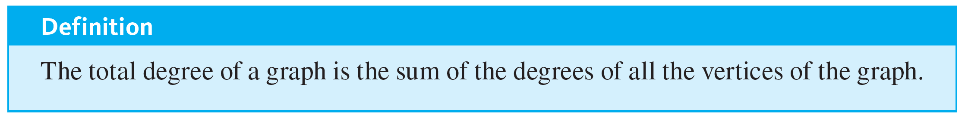
Application: The Handshake Theorem

Slide 4
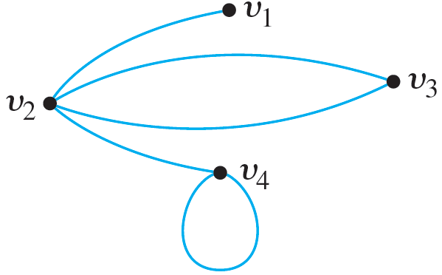
Example 4.9.1 – The Total Degree of a Graph
Find the degree of each vertex of the graph G shown below, and then find the total degree of the graph.

Slide 5
Example 4.9.1 – Solution
deg(v₁) = 1; deg(v₂) = 4; deg(v₃) = 2; deg(v₄) = 3
total degree of G = 1 + 4 + 2 + 3 = 10

Slide 6
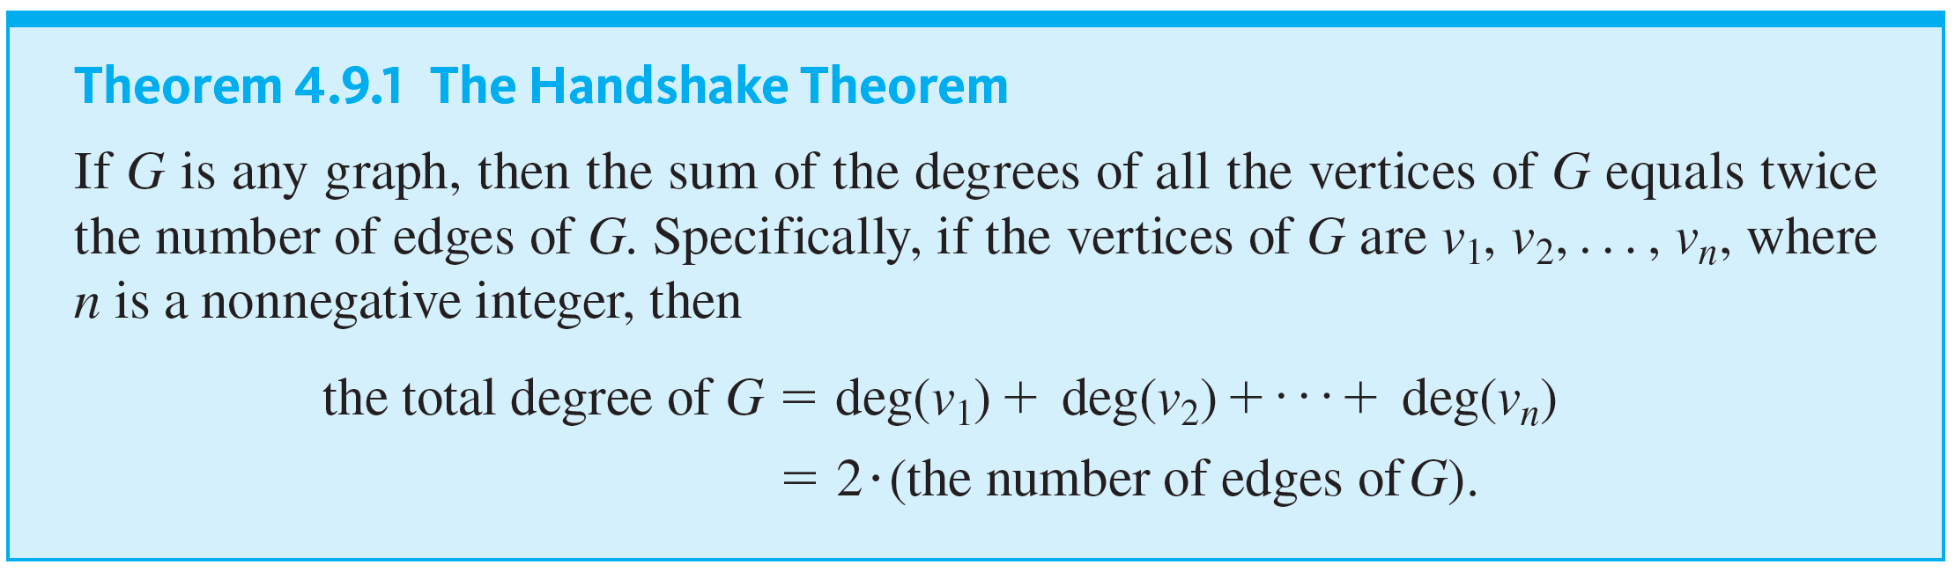
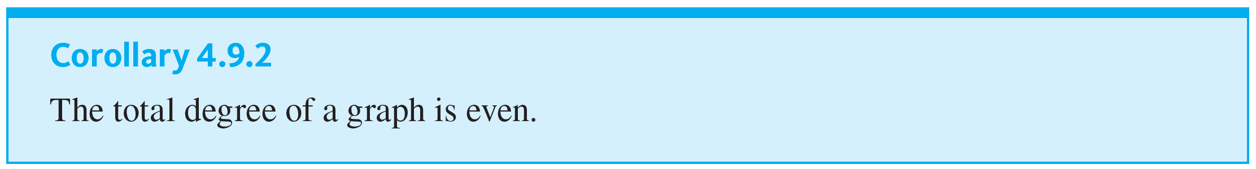
Application: The Handshake Theorem

Slide 7
Example 4.9.2 – Determining Whether Certain Graphs Exist
Draw a graph with the specified properties or show that no such graph exists.
a. A graph with four vertices of degrees 1, 1, 2, and 3
b. A graph with four vertices of degree 1, 1, 3, and 3

Slide 8
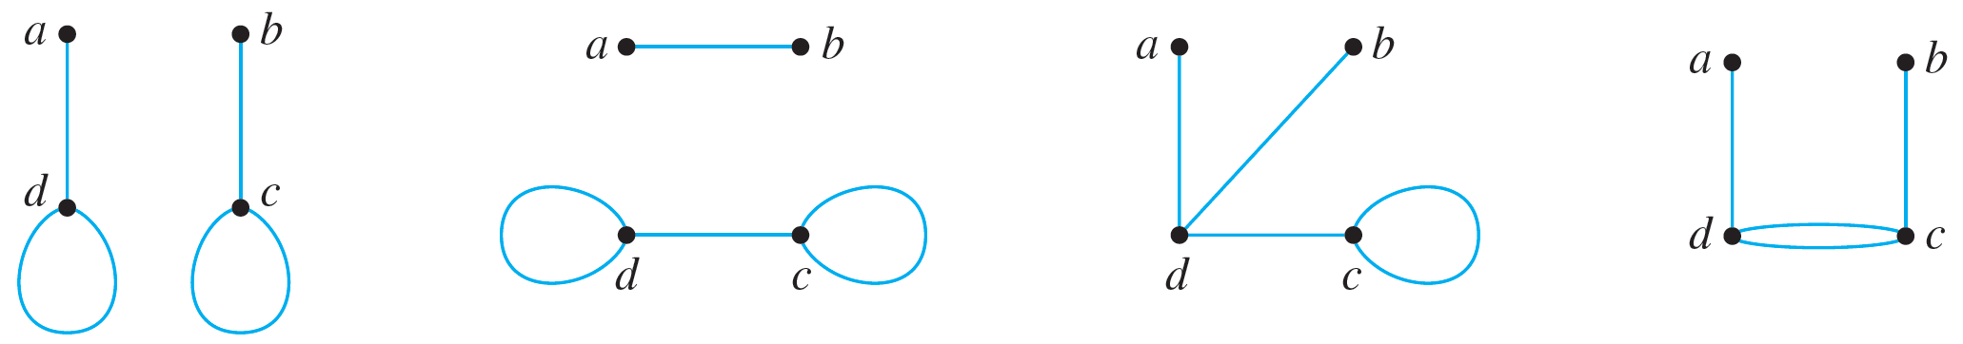
Example 4.9.2 – Solution
a. No such graph exists. By Corollary 4.9.2 the total degree of a graph is even. But a graph with four vertices of degrees 1, 1, 2, and 3 would have a total degree of 1 + 1 + 2 + 3 = 7, which is odd.
b. Let G be any of the graphs shown below.

Slide 9
Example 4.9.2 – Solution
continued
In each case, no matter how the edges are labeled, deg(a) = 1, deg(b) = 1, deg(c) = 3, and deg(d) = 3.

Slide 10
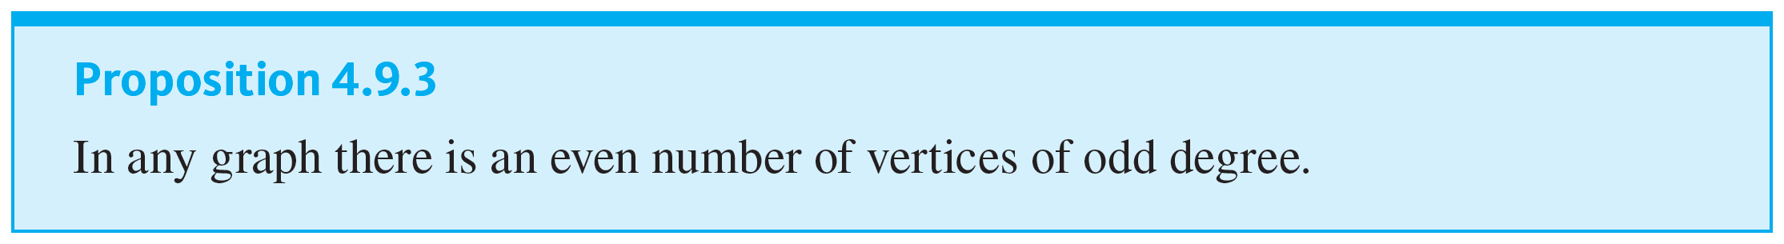
Application: The Handshake Theorem

Slide 11
Example 4.9.4 – Applying the Fact That the Number of Vertices with Odd Degree Is Even
Is there a graph with ten vertices of degrees 1, 1, 2, 2, 2, 3, 4, 4, 4, and 6?

Slide 12
Example 4.9.4 – Solution
No. Such a graph would have three vertices of odd degree, which is impossible by Proposition 4.9.3.
Note that this same result could have been deduced directly from Corollary 4.9.2 by computing the total degree (1 + 1 + 2 + 2 + 2 + 3 + 4 + 4 + 4 + 6 = 29) and noting that it is odd. However, Proposition 4.9.3 gives the result without the need to perform this addition.

Slide 13
Example 4.9.5 – How Many People Attended the Meeting?
At a meeting attended by a group of people, four people shook hands with one other person, six people shook hands with two other people, two people shook hands with three other people, and the rest shook hands with four other people. No two people shook hands with each other more than once, and a total of 23 handshakes occurred. How many people attended the meeting?

Slide 14
Example 4.9.5 – Solution
Define a graph G by letting each vertex represent a person at the meeting and letting each edge represent one handshake between two people. Let x be the number of people who shook hands with four other people. Then
the total degree of the graph
= 4 · 1 + 6 · 2 + 2 · 3 + x · 4 = 22 + 4x
because 4 people shook hands with 1 other person, 6 people shook hands with 2 other people, 2 people shook hands with 3 other people, and x people shook hands with 4 other people.

Slide 15
Example 4.9.5 – Solution
continued
In addition, since a total of 23 handshakes occurred, the graph has 23 edges. By the handshake theorem (Theorem 4.9.1), the total degree is twice the number of edges.

Slide 16
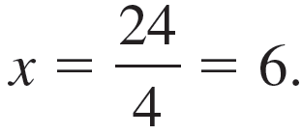
Example 4.9.5 – Solution
continued
Hence
the total degree of the graph = 2 · 23 = 46.
It follows that
22 + 4x = 46.
Thus
4x = 46 − 22 = 24,
and so

Slide 17
Example 4.9.5 – Solution
continued
In other words, six people at the meeting shook hands with four other people. Now the total number of people at the meeting is the sum of the number who shook hands with one other person, plus the number who shook hands with two other people, plus the number who shook hands with three other people, plus the number who shook hands with four other people.
Therefore,
the number of people at the meeting = 4 + 6 + 2 + 6 = 18.

Slide 18
Special Graphs

Slide 19
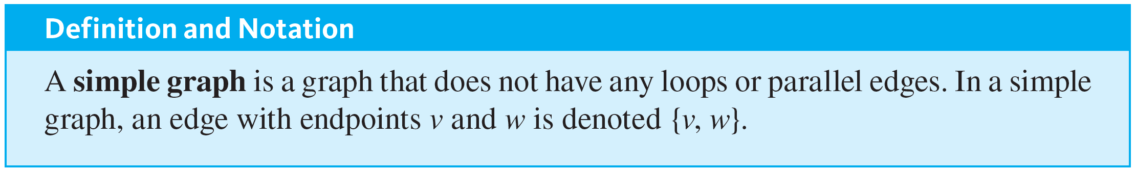
Special Graphs

Slide 20
Example 4.9.6 – Some Simple Graphs
Draw all simple graphs with the four vertices {u, v, w, x} and two edges, one of which is {u, v}.

Slide 21
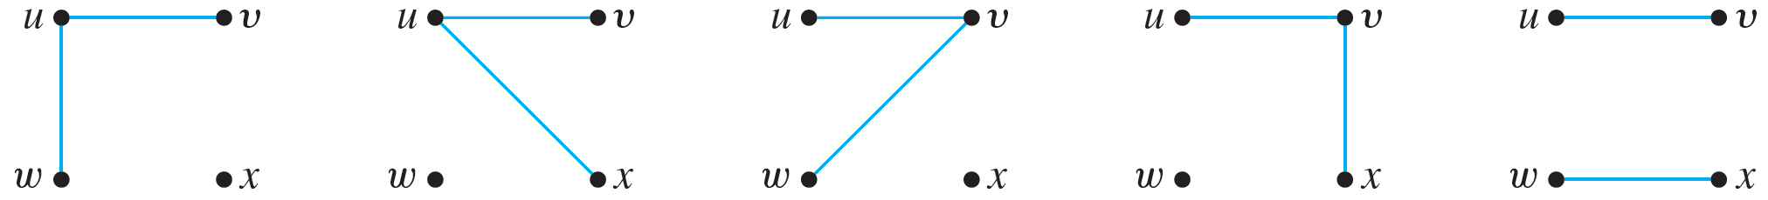
Example 4.9.6 – Solution
Since one edge of the graph is specified to be {u, v}, the possibilities for the other edge are {u, w}, {u, x}, {v, w},
{v, x}, and {w, x}.
The resulting graphs are shown below.

Slide 22
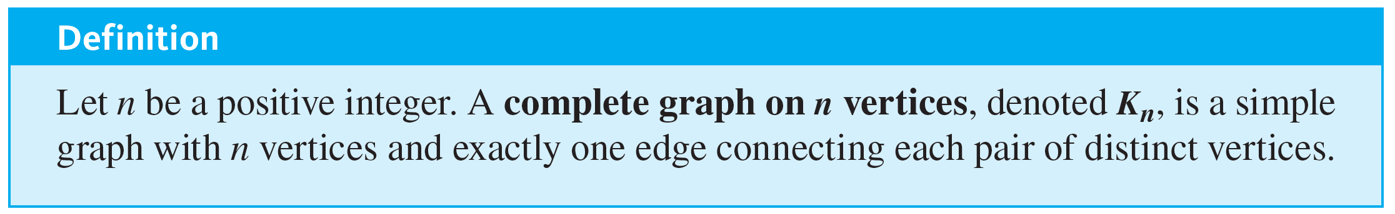
Special Graphs

Slide 23
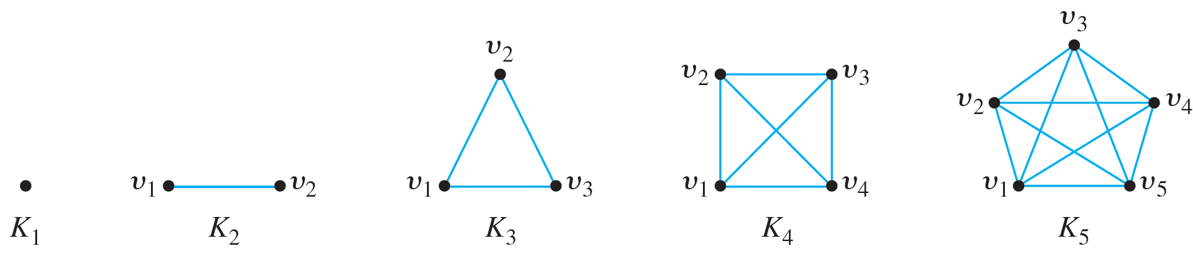
Example 4.9.8 – Complete Graphs on n Vertices: K₁, K₂, K₃, K₄, K₅
The complete graphs K₁, K₂, K₃, K₄, and K₅ can be drawn as follows:

Slide 24
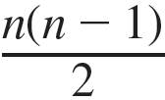
Example 4.9.9 – The Number of Edges of K_{n}
Prove that for any positive integer n, a complete graph on n
vertices has
edges.

Slide 25
Example 4.9.9 – Solution
Suppose n is a positive integer and K_{n} is a complete graph on n vertices. Because each vertex of K_{n} is connected by exactly one edge to each of the other n − 1 vertices of K_{n}, the degree of each vertex of K_{n} is n − 1.
Thus

Slide 26
Example 4.9.9 – Solution
continued
By the handshake theorem (Theorem 4.9.1), the total degree of K_{n} equals twice the number of its edges.
So since the total degree is n(n − 1),
n(n − 1) = 2 · (the number of edges of K_{n})

Slide 27
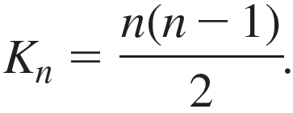
Example 4.9.9 – Solution
continued
Dividing by 2 gives that
the number of edges of

Slide 28
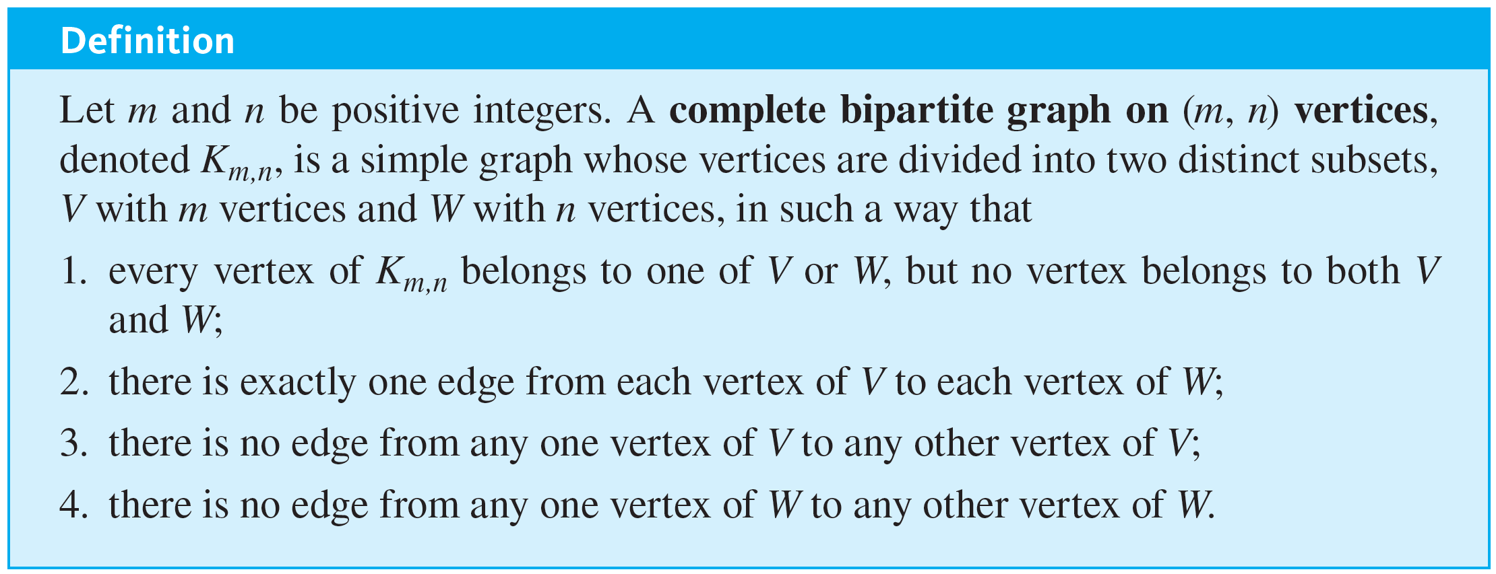
Special Graphs

Slide 29
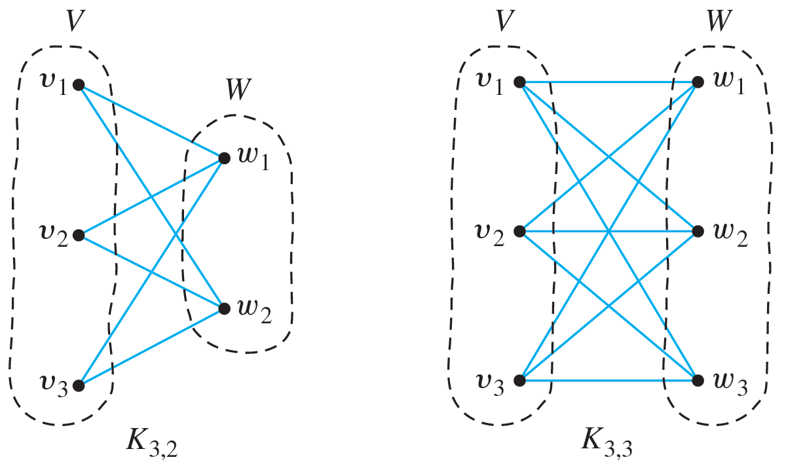
Example 4.9.10 – Complete Bipartite Graphs: K_{3,2} and K_{3,3}
The complete bipartite graphs K_{3,2} and K_{3,3} are illustrated below.

